Slide 1
An Indigenous Superhero’s Journey: A Comparative Study of The Heroes and Hero Twins
Melissa Kocelko
University of Denver
MA Candidate
Notes:
My name is Melissa Kocelko and I am second year MA candidate in Anthropology.
This project, to borrow from Richard Linklater, is the spiritual sequel to my thesis which briefly is looking at Indigenous comic books from story creation story production.

Slide 2
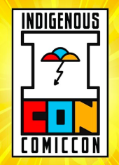

Slide 3
questions
1)What are Indigenous comics?
2)What does it mean to be an Indigenous comic book superhero?
3)What do we do with canon when there are two origin stories for the same superheroes?
Notes:
What is canon?
The material that is accepted (this is where we define by who) to be officially apart of the story in the fictionalized universe
Canon distinguishes itself from other works. i.e. American literary canon to European; ties to playing Indian
Indigenous literary canon
Forming a literary canon as a means of building a cultural identity is hardly an uncommon concept either as this process continues to take place event today

Slide 4
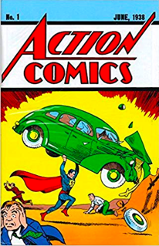
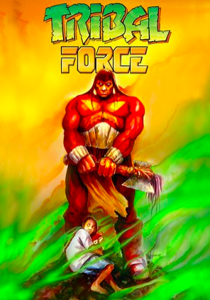
Superhero Qualities
Biological?
Action Comics, 1938
Tribal Force, 1996
Notes:
They’re born with it. Can be seen with Superman or in Indigenous superhero comics Kagagi: The Raven.

Slide 5
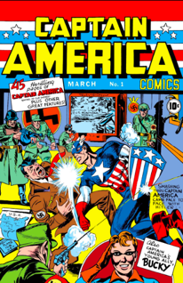
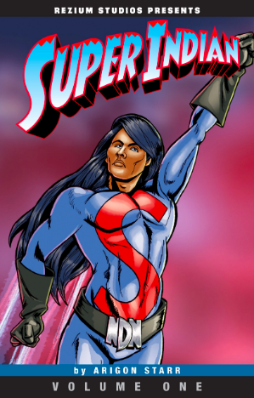
Superhero Qualities
Mutation?
Captain America, 1941
Super Indian, 2012
Notes:
They weren’t born with superhuman abilities but through a scientific experience (Captain America) or from eating chemicals in tainted commodity cheese (Super Indian) they come to now have superhuman abilities. Or in the case of Ironman or Cyborg, they have posthuman modifications that blend technology and humans.

Slide 6
Superhero Qualities
“To me a superhero is someone with extraordinary abilities that chooses to use those abilities to help people […] it doesn't have to be anyone that has superpowers. It could be someone who just who is willing to help people with whatever they have.” (Deforest 2019)
Notes:
Since it is a subjective matter, we will defer to definitions given by the creators of the works we will explore.

Slide 7
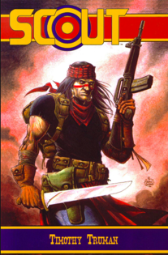
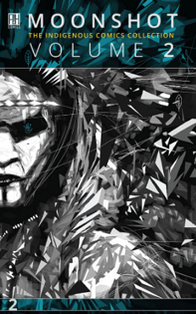
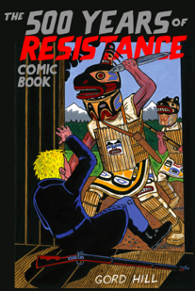
Indigenous Comic Books
Truman, 1985
Moonshot 2, 2017
(Hill 2010)
Notes:
The medium of comics involves any and all genre, and Indigenous comics are no different.
I borrow from Jack Forbes’ definition of Indigenous literature and extend it to Indigenous comics; where Indigenous comic books are comics created by and intended largely for an Indigenous audience (Forbes 1987).
Some popular genres depicted in Indigenous comics are Native Noir or detective comics, sci-fi or Indigenous Futurisms as seen in the Moonshot anthologies, and post-apocalyptic, dystopia dramas.

Slide 8
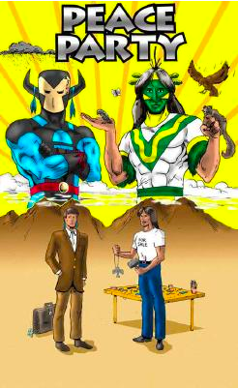
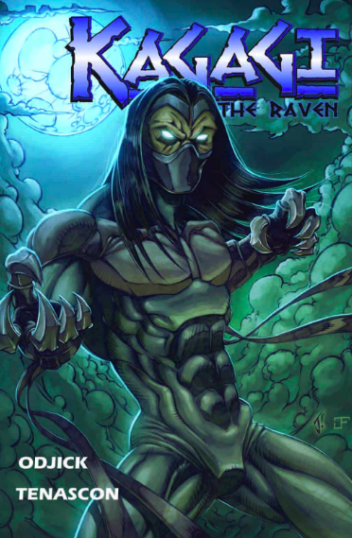
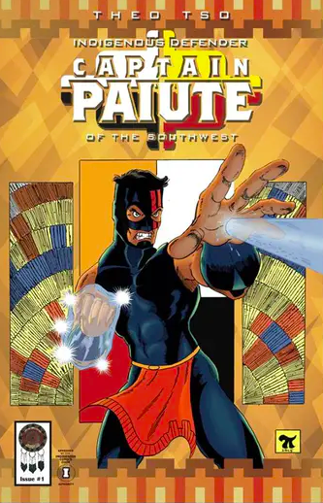
Indigenous Comic Book Superheroes
Peace Party, 2000
Kagagi, 2007
Captain Paiute, 2015
Notes:
Just as Indigenous comic books inhabit a wide variety of genres, so too does the Indigenous superhero genre. The heroes have a different abilities but a common theme among the majority of them is that they fight against issues that Indigenous people encounter on a daily basis and that they were created to combat Indigenous representation from mainstream characters.
These causes vary from racial discrimination from whites, alcohol addiction, cultural appropriation, and more.

Slide 9
Diné Bahane’
(Navajo creation story)
Notes:
Before we get to the comics themselves, let’s take a moment to talk about where the Hero Twins came from.
This is coming from my perspective as an anthropologist.
In the Dine Bahane or the Navajo Creation story, there are four worlds and we will focus on the fourth world as that’s where our characters come from.
Changing Woman and her twins Born for Water and Monster Slayer live in a world inhabited by monsters, they learn from their father the Sun, and he teaches them to defeat the monsters that are attacking people. They restore harmony or hozho.

Slide 10
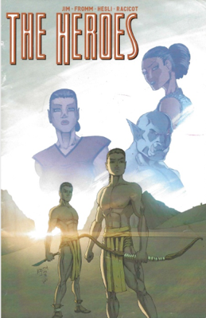
The Heroes
Keith Jim
Notes:
2018’s self-published work The Heroes is drawn by and comes from Keith Jim’s family.
The story is told in English but uses Dine words for places and names. This is intentional as Keith views his comic and comics as a form of education.

Slide 11
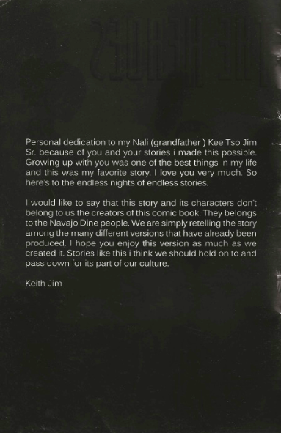
The Heroes
Keith Jim

Slide 12
The Heroes
Characters
Changing Woman
Monster Slayer
Naayee Neizghani
Born for Water
Tobajischini
Spider Woman
Keith Jim

Slide 13
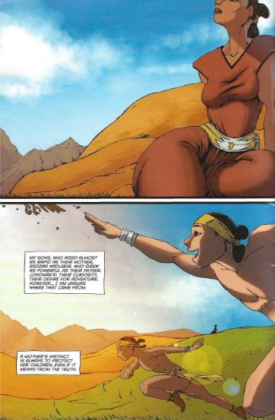
The Heroes
Keith Jim
Page 2

Slide 14
The Heroes
Story Arc
It is the twins journey of self-discovery.
They do not know who their father, they are asked by mankind to fight off the monsters, and they travel to learn from others.
Keith Jim
Notes:
They answer the call of the children. They have extraordinary abilities and choose to use those to help people; i.e. they meet our definition of a superhero.

Slide 15
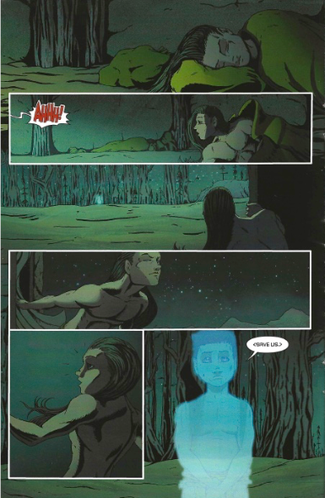
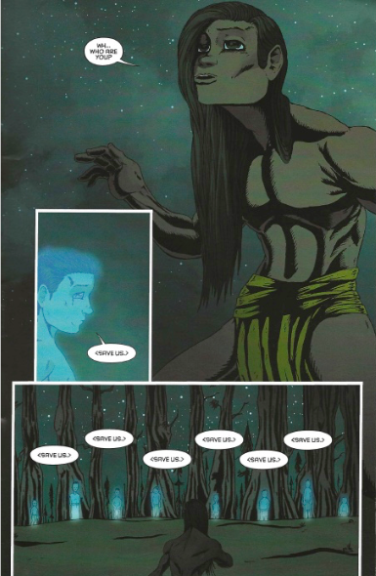
Page 8
Page 9

Slide 16
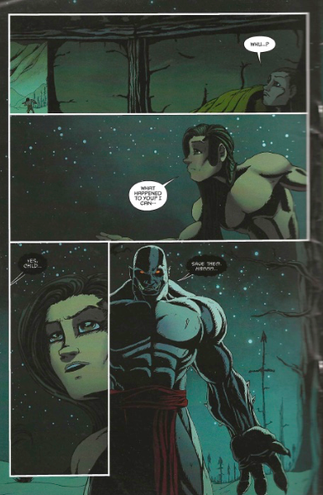
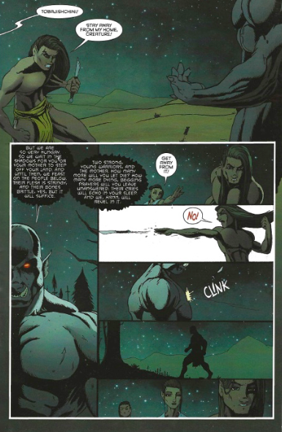
Page 10
Page 11
Notes:
Monster introduction with the heroes and their subsequent “battle”/interaction

Slide 17
The Heroes
“people don't know this story and I don't mind sharing it with them [...] it's the way my grandfather told me.” (Jim 2019)
“It is a story that is one of our traditional stories that is being forgotten.” (Jim 2019)
Keith Jim

Slide 18
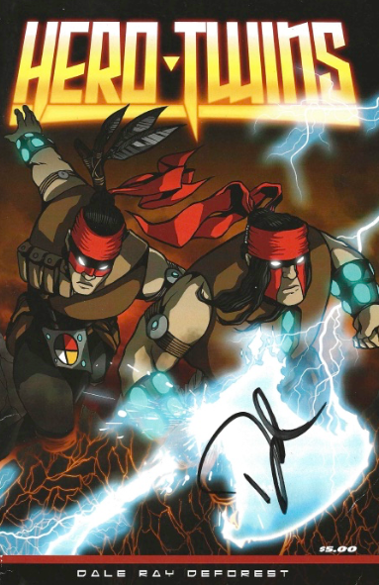
Hero Twins
Dale Ray Deforest
Notes:
2016’s self-published work Hero Twins is drawn from Dale’s imagination.
“This story you’ve just read is intended to be a fictional departure from Diné folklore. Imagine this book is the movie and the Navajo Creation Story is the book this movie is based on. Of course I’m not going to hit the nail on the head nor do I want to. This is MY story, my contribution to pop culture in an effort to say, “Well, as a matter of fact, THERE ARE Native American Superheroes.”” (Hero Twins Page 28)

Slide 19
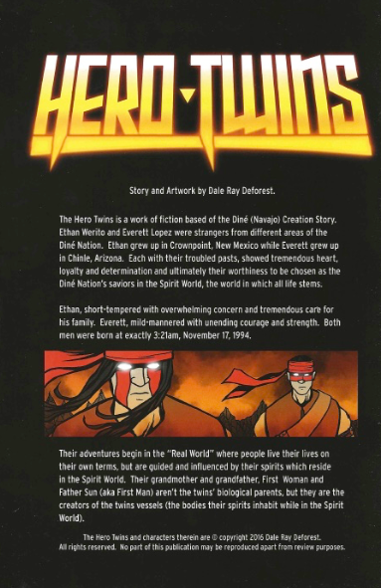
Hero Twins
Dale Ray Deforest
Notes:
Similar to Keith, Dale has a page dedicated to how his comic came to be; where his inspiration came from.

Slide 20
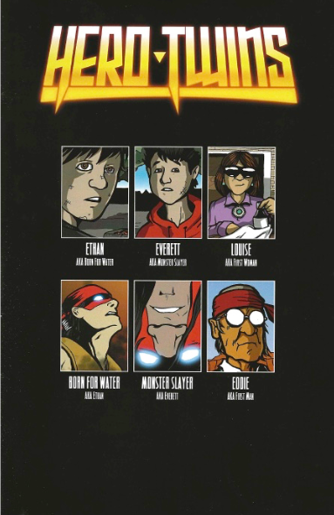
Hero Twins
Dale Ray Deforest

Slide 21
Hero Twins
Story Arc
It is the twins battle with a monster.
Along the way they learn lessons from Louise (First Woman) and Eddie (First Man) on how to harness their superhero abilities.
Dale Ray Deforest

Slide 22
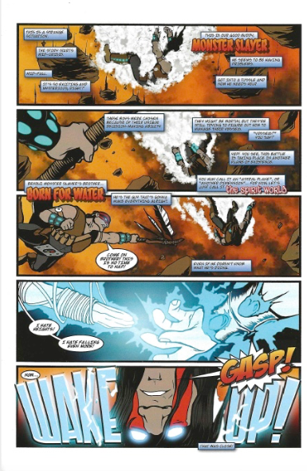
Page 4
Notes:
Monster introduction with the heroes and their subsequent “battle”/interaction

Slide 23
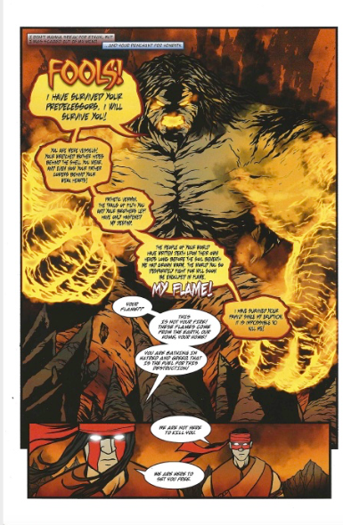
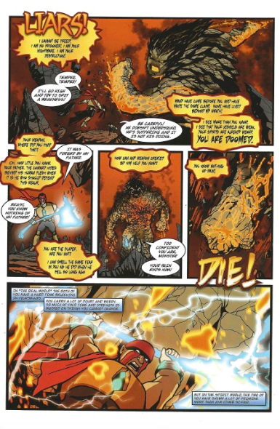
Page 10
Page 11
Notes:
Their battle with the monster; much different from The Heroes and is full of action.

Slide 24
Hero Twins
“I'm not trying to write a story that's already written or that's been passed on orally. You know I have my story [...] it's based in Navajo tradition but that's as far as it goes. I have my characters that are inspired from the Navajo creation story but they're not directly lifted from that” (Dale 2019)
Dale Ray Deforest

Slide 25
Comparative Analysis

Slide 26
Character Introduction
The Heroes
Hero
Twins
Page 2
Page 4
Notes:
Both are introduced and narrated by Changing Woman (The Heroes) or Louise (First Woman).
Both women introduce the twins; they do not introduce themselves. This anchors our understanding and relation to them through female matriarch figures.
Changing Woman in The Heroes is the first character we meet in Panel 1 which I believe reiterates her importance in the Dine Bahane.
In Hero Twins we do not meet Louise or First Woman until page 7 but it is through her that we learn the storyworld of the “Spirit World”, the boys, their power, and even teases us that the boys do not know their father.

Slide 27
Battle with the Monster
The Heroes
Hero
Twins
Page 11
Page 11
Notes:
The first battle or “battle” coincidently occur on the same page within each comic.
Both interactions are representative of their overall story arcs. While The Heroes focuses more on inner conflict, Hero Twins is action based and all about the battle.
The colors establish the mood and tone of the comic and between the two help support this. It looks like Fire and Ice. While

Slide 28
Analysis

Slide 29
Education
Both creators want their comics to inspire others to learn about their history or Dine history.
Dale
“It’s my story with elements of other stories. Every creator does that. But the inspiration behind that — maybe it will inspire someone to go do their own research about Hero Twins” (Locke 2018)
Keith
“My goal is keep it close to the original story. Some stories like The Heroes are part of our creation story. Where we came from.” (Jim 2019)

Slide 30
Theory
Tribal Critical Race Theory
Counternarratives
Importance of Storytelling
“stories and other media, are roadmaps for our communities and reminders of our individual responsibilities to the survival of our communities” (Brayboy 2005, 427)
Postmodernism
Critiques of metanarratives
Multivocality
“postmodern as incredulity toward metanarratives” (Lyotard 1984, XXIV)

Slide 31
Canon
Comic book superheroes are distinct in American mythology and literary canon, and as such, of course Indigenous comic book superheroes have canon.
Based on versus Inspired by
They are both canon
Notes:
Based on their story origin (based on vs. inspired by) and theories emphasizing the importance of multiple perspectives in space. The Heroes and Hero Twins are both canon.
They are both canon because they both tell the story of two different sets of twins.

Slide 32
Conclusion
1)What are Indigenous comics?
Indigenous comic books are comics created by and intended largely for an Indigenous audience.

Slide 33
Conclusion
2)What does it mean to be an Indigenous comic book superhero?
They fight against issues that Indigenous people encounter on a daily basis and that they were created to combat Indigenous representation from mainstream characters.

Slide 34
Conclusion
3)What do we do with canon when there are two origin stories for the same superheroes?
Trick question. They’re not the same superheroes but they do share the same names.

Slide 35
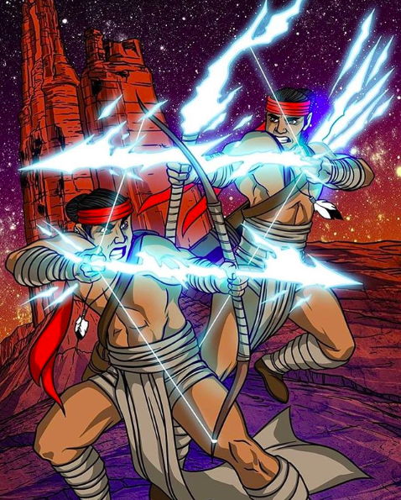
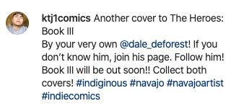
Legends Supporting Legends
“I think it was Dale’s book I picked up first. I love his cover. I was like, "Whoa like I know this story, I want to see how this goes." It was the first comic of the twins I picked up.” (Jim 2019)
Ktj1comics, 2020

Slide 36
Readers Supporting Legends
Keith Jim
Instagram
Ktj1comics
Facebook
@KTJ1Comics
The Heroes 3 is currently in production
Dale Ray Deforest
Instagram
Dale_deforest
Personal Website
daledeforest@gmail.com
Hero Twins continue to be produced through Native Realities

Slide 38
Works Cited
Brayboy, Bryan McKinley Jones. 2005. “Toward a Tribal Critical Race Theory in Education”. In The Urban Review, Vol. 37, No. 5, (December), Pp. 427..
Deforest, Dale Ray. Interview by Melissa Kocelko. Personal Interview. Phone. November 15, 2019.
Forbes, Jack. 1987. “Colonialism and Native American Literature: Analysis.” In Wicazo Sa Review, Vol. 3, No. 2 (Autumn), Pp. 17-23.
Helvie, Forrest, C. 2013. “Capes and the Canon: Comic Book Superheroes and Canonical American Literature.” PhD diss, Indiana University of Pennsylvania.
Jim, Keith. Interview by Melissa Kocelko. Personal Interview. Phone. October 11, 2019.
Locke, Katherine. 2018. “Author and illustrator Dale Deforest presents new comic book “Hero Twins.” In Navajo-Hopi Observer. https://www.nhonews.com/news/2018/apr/24/author-and-illustrator-dale-deforest-presents-new-/
Lyotard, Jean-François. 1984. The Postmodern Condition: A Report on Knowledge. In Theory and History of Literature, Vol. 10. University of Minnesota. Pp. XXIV.

Slide 39
Images Cited
Action Comics. “Superman” 1938. https://www.amazon.com/Action-January-Reprints-Appearance-Superman/dp/B01MTC6IPJ
Batman. 1940. https://www.pinterest.co.uk/pin/551761391823158175/
Captain America.1941. https://www.marvel.com/comics/issue/7849/captain_america_comics_1941_1
Hill, Gord. 2010.”500 Years of Resistance: A Comic Book.” https://www.amazon.com/500-Years-Resistance-Comic-Book/dp/1551523604
Ktj1comics. 2020. “Another cover to The Heroes: Book III.” https://www.instagram.com/p/B8PjbbHlPRF/
Moonshot. 2017. “Moonshot: The Indigenous Comics Collection Volume 2.” http://ahcomics.com/wordpress/moonshot-volume-2/
Odjick, Jay. 2007. “Kagagi: The Raven.” https://www.comixology.com/Kagagi-The-Raven/digital-comic/19189
Peace Party. 2000. “Peace Party, Issue 13.” http://www.turtletrack.org/IssueHistory/Issues00/Co07012000/CO_07012000_PeaceParty.htm
Proudstar, Jon. 1996. “Tribal Force.” https://www.npr.org/2017/04/02/522223987/with-this-publisher-native-american-superheroes-fly-high
Starr, Arigon. 2012. “Super Indian Volume 1.” https://www.amazon.com/Super-Indian-One-Arigon-Starr/dp/9870985955
Tso, Theo. 2015. “Captain Paiute: Indigenous Defender of the Southwest.” https://newsmaven.io/indiancountrytoday/archive/native-american-comics-creator-showcase-theo-tso-and-captain-paiute-v1mVu7mfOkahSv0bW212Lg
Truman, Timothy. 1985.”Scout. Volume 1, Issue 1.” https://www.amazon.com/Scout-Vol-1-v/dp/1933305959

Slide 40
Thank You
melissa.kocelko@du.edu

